Slide 1
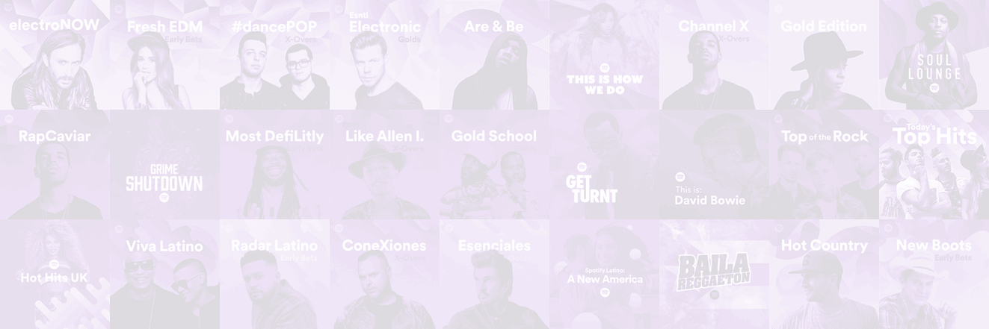
HUSKY MUSIC PLAYER
Skanda Srinivasan
Ronit Chougule
Sahil Mattoo
Bhargavi Rao
Chinmay Rout
Web Design/User Experience Engineering | INFO6150

Slide 2
TRACKS
ALBUMS
ARTIST DASHBOARD
ARTISTS
Components
PLAYER
PLAYLISTS

Slide 3
Roles
USER :
User can view albums, artists, all tracks available, subscribe for premium, like songs etc.
ARTIST :
Artists can create Albums, add songs into Albums and upload the songs to cloudinary etc.

Slide 4


APIS Used
This project mainly uses two different third party APIs

Slide 5

Technologies

Slide 6
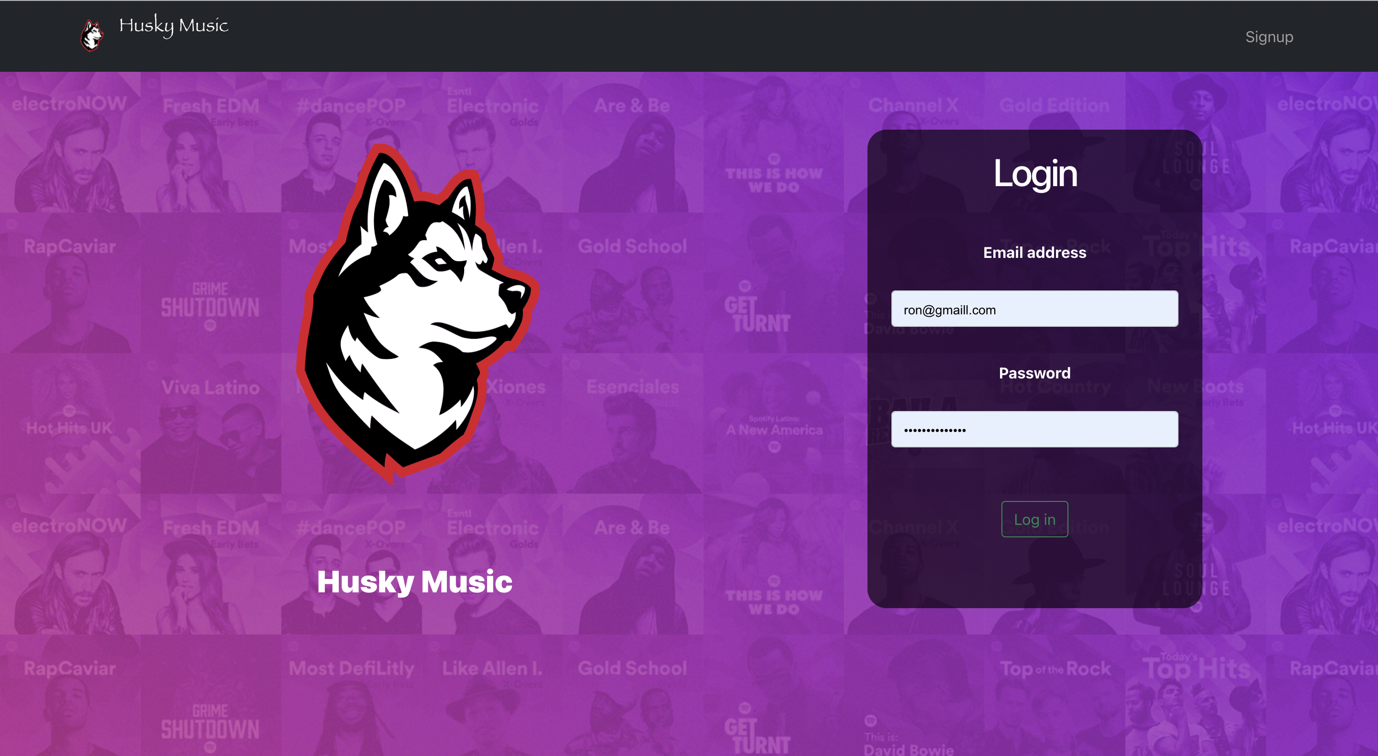
Application home/login
USER INTERFACE

Slide 7
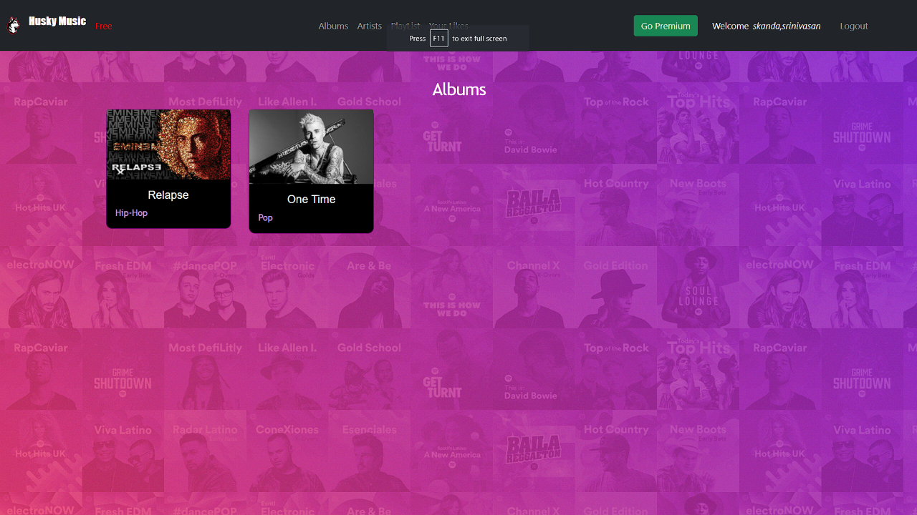
Album page

Slide 8
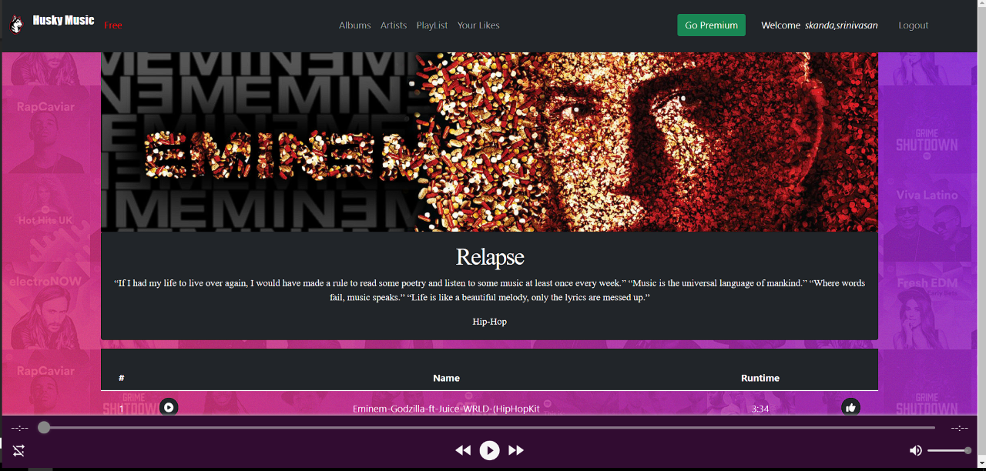
Tracks page

Slide 9
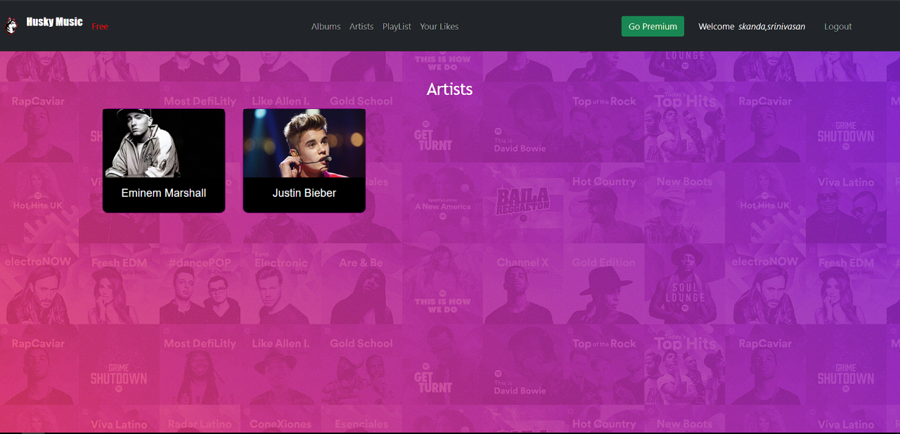
Artist page

Slide 10
THANK YOU!

